Slide 1
Simple forms
Dr. Navneet Kaur

Slide 2
CSRF
CSRF stands for Cross-Site Request Forgery, which is a type of security vulnerability.
In Django, CSRF protection is a security measure to prevent this vulnerability.

Slide 3

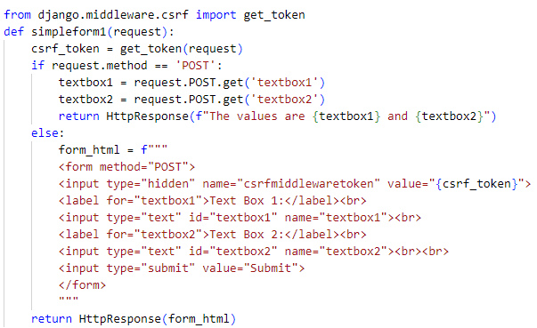
Forms using HTTP response
view.py

Slide 4

Forms using HTTP response
urls.py

Slide 5
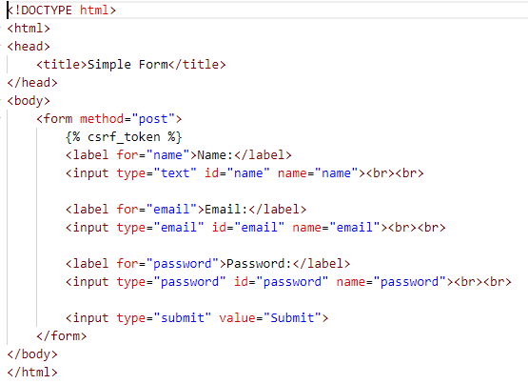
Forms using templates
form.html

Slide 6
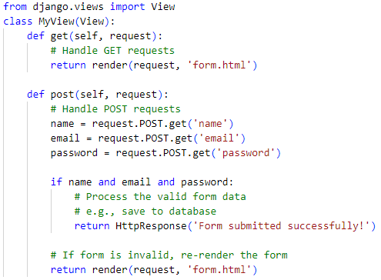
Forms using templates
views.py

Slide 7

Forms using templates
urls.py

Slide 8
Post Redirect Refresh pattern
In Django, Post/Redirect/Get (PRG) is a design pattern used to prevent duplicate form submissions and improve user experience.
Post: When a user submits a form (via POST request) on a web page, data is sent to the server for processing, such as saving to a database.
Redirect: After processing the form data, instead of directly displaying a response to the user, Django issues a redirect response to a different URL.
Refresh: When the browser receives the redirect response, it makes a new GET request to the redirected URL. This means if the user tries to refresh the page, they are not resubmitting the form; instead, they are reloading the redirected page.

Slide 9
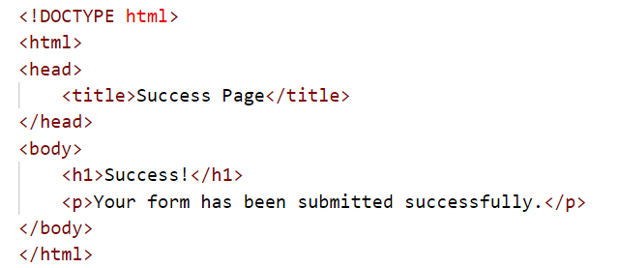
Post Redirect Refresh pattern
success.html

Slide 10
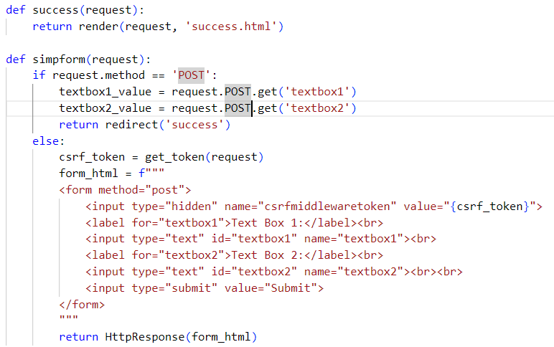
Post Redirect Refresh pattern
views.py

Slide 11

Post Redirect Refresh pattern
urls.py

Slide 12
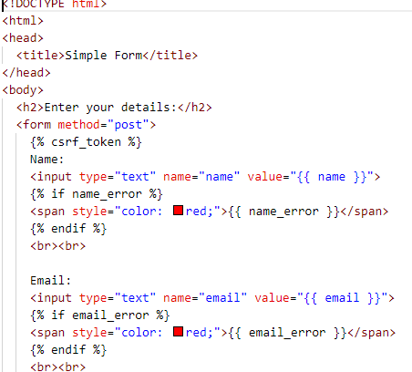
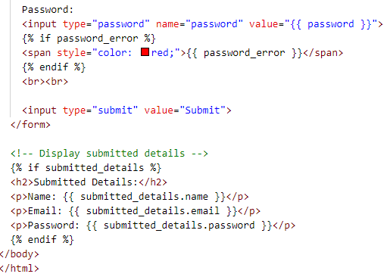
Form validation
validate_form.html

Slide 13
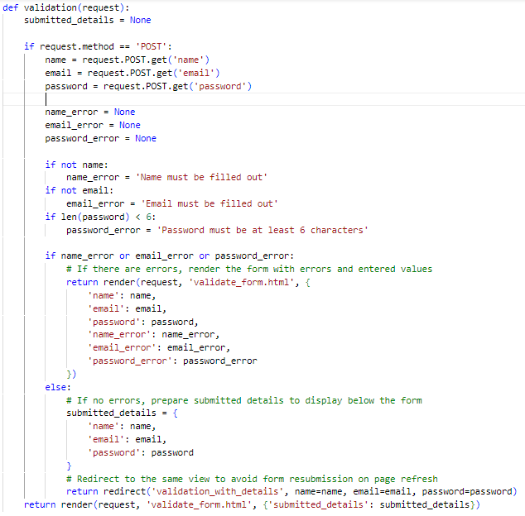
Form validation
views.py

Slide 14
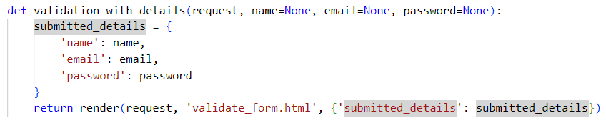
Form validation
views.py

Slide 15
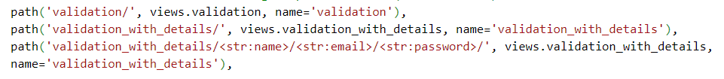
Form validation
urls.py

